Slide 1


Hope to Skills
Lecture# 10
Irfan Malik, Dr. Sheraz Naseer

Slide 2
Agenda
How to Explore the Hugging Face
Pipelines
Models
Datasets
Name Entity Recognition
Image Classification

Slide 3
Recap
What is Hugging face?
Why hugging face?
What are Hugging face pipelines?
What is Inference?

Slide 4
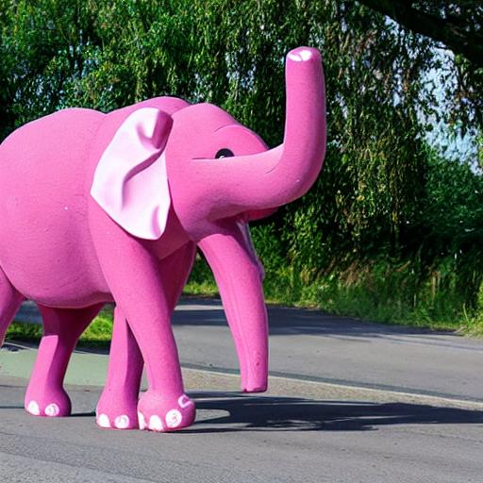

Slide 5
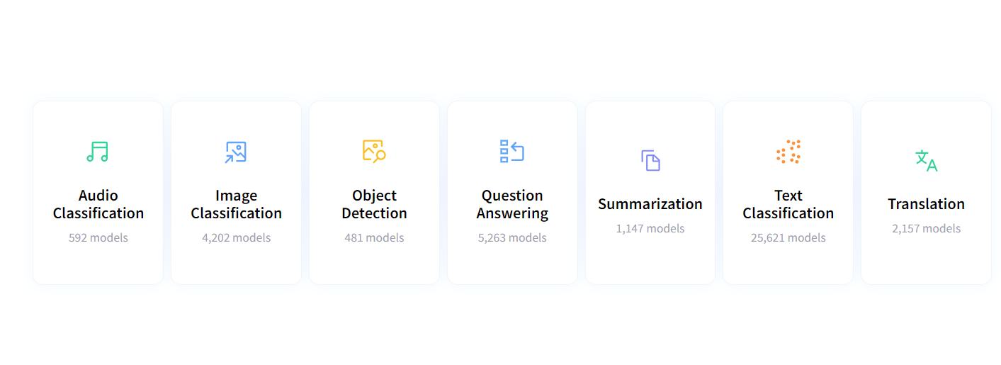
How to use Hugging Face (click here)

Slide 6
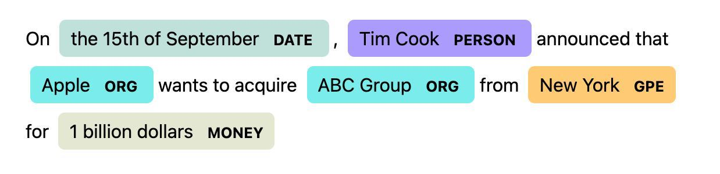
Name Entity Recognition (NER)
Named Entity Recognition (NER) is a subtask of Natural Language Processing (NLP) that focuses on identifying and classifying named entities in text.
Named entities are real-world objects such as persons, organizations, locations, dates, and more.

Slide 7
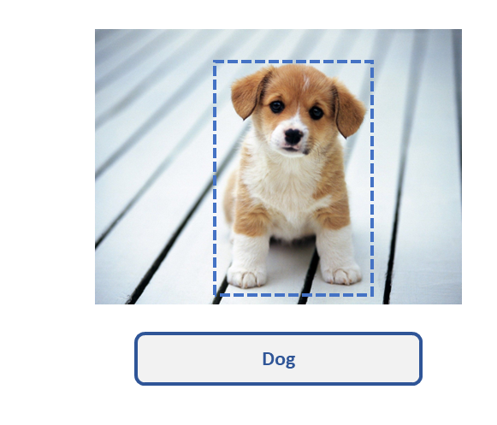
Image Classification

Slide 8
Google Colab Notebook

Slide 9
Summary
Hugging Face library
Hugging Face pipelines
How to explore the Hugging face

